Slide 1

ANALYSIS OF CALORIES BURN USING MACHINE LEARNING TECHNIQUES
1) Sai Kiran Ande (700741579)
2) Taranmeeth Kaur Sardar (700723388)
3) Yamini Macherla (700733827)
4) Sri Snigdha Madisetty (700742420)

Slide 2
ROLES/RESPONSIBILITIES AND CONTRIBUTION OF PROJECT
Data Read and Preprocessing – Sai Kiran and Yamini Macherla
Result Analysis and References – Taranmeeth Kaur Sardar and Sai Snigdha
PPT report and Code implementation - Sai Kiran and Yamini Macherla
Literature Review and Objectives - Taranmeeth Kaur Sardar and Sai Snigdha
Dataset, rectifying the errors and data description - Sai Kiran,Yamini Macherla, Taranmeeth Kaur Sardar and Sai Snigdha

Slide 3
MOTIVATION
The vast majority of experts are of the opinion that the decisions an individual makes on a daily basis can have substantial implications for their health
Wearable technology such as the Fitbit and the Apple Watch are capable of collecting vast amounts of data in real time from the sensors built into the devices.
We can use the data from these devices to predict no of calories burn each individual using regression techniques.

Slide 4
OBJECTIVES
Gather all statistics of the dataset
Data Cleaning
Data analysis
Data preparation
Building regression Model

Slide 5
RELATED WORK
Rachael, Stephen, Lixing, & Omar analyzed health analyzed the student health behavior , particularly sleep and exercise habits analyzed stastically using fitbit data.
Despite the fact that numerous researchers have utilized dimension reduction and outlier identification to identify abnormal sleeping habits in time series data (Zilu, Mario, Chapa, & Takuichi, 2016)
Many of the examined research also make use of data mining, machine learning, and deep learning. As an example, one study differentiates between stages of sleep by employing a deep neural hybrid network architecture composed of CNN and LSTM layers. (Shashank, Abdallah, & Pablo, 2019) .
Heart disease has been classified using supervised classification algorithms, and the patient's vital signs have been discussed in relation to the condition (Poojitha, Nikhita, Khurana, Sneha, & Weneen, 2019)

Slide 6

PROBLEM STATEMENT
Many people want to know how their workout results instantly rather keep checking their weight daily.
They need a system predict the number of calories they might burn for a certain exercise for time.
People who want to know the results of their workout can use our best model to get accurate results and let them schedule their time for their workout.

Slide 7
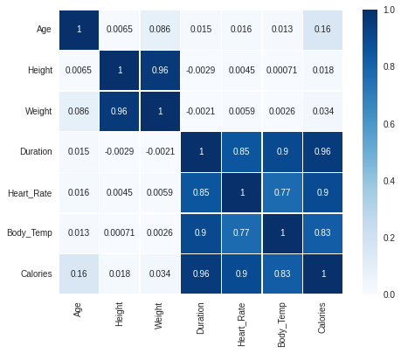
CORRELATION MATRIX OF FEATURES WE HAVE TAKEN

Slide 8
PROPOSED SOLUTION
We have created two regression models to calculate no of calories burn:
Linear Regression
Random Forest Regression
The random forest model we considered has resulted the low error values compared linear model.

Slide 9
Linear Model:
Mean Absolute Error 8.52
Mean Squared Error 140.08
Root Mean Squared Error 11.84
Random Forest Model:
Mean Absolute Error 5.34
Mean Squared Error 69.17
Root Mean Squared Error 8.32

Slide 10
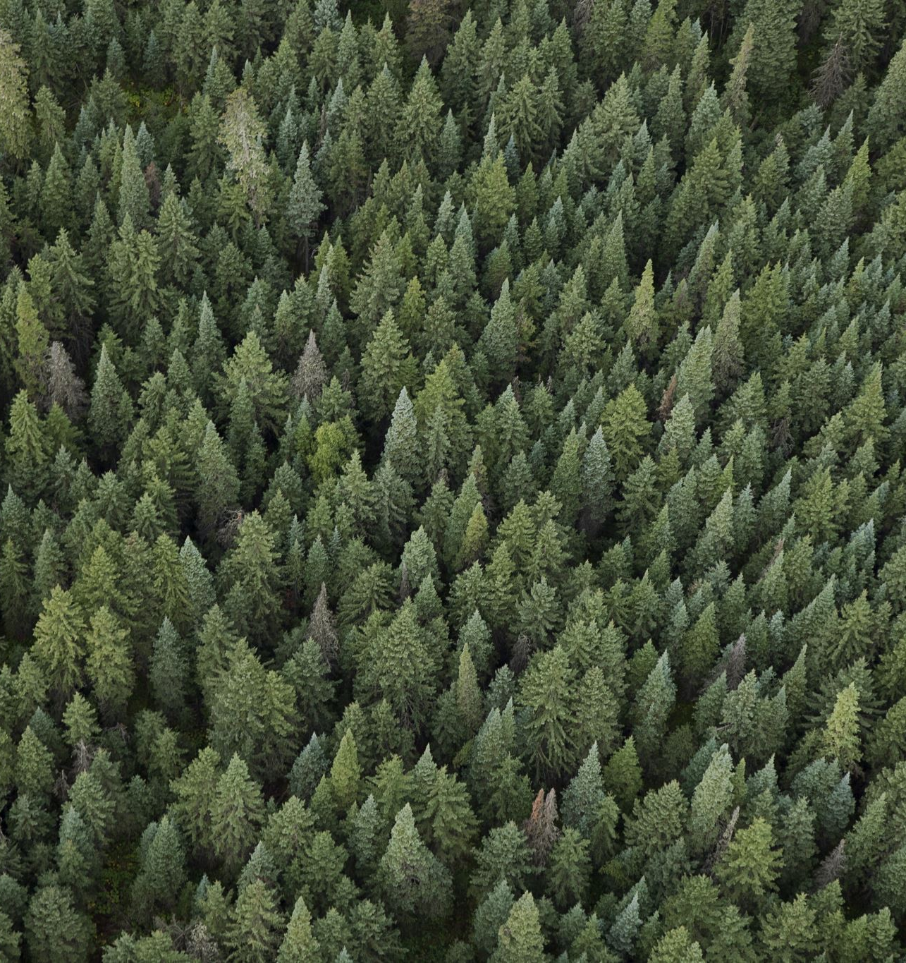
RESULTS
There is no one-to-one correlation between, say, duration and either weight or height. This is because, regardless of BMI or height and weight, different people will have varying workout durations.
The Random Forest Regression model can pickle and deployed into user's wearable devices.

Slide 11

Thank You

